Slide 1
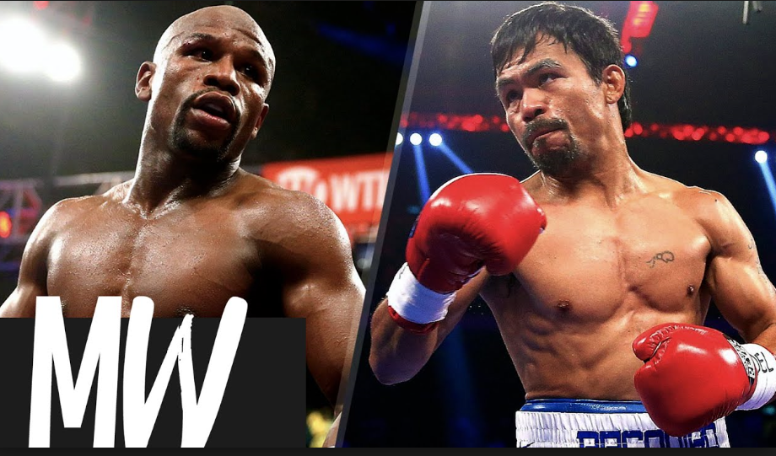
Data Visualization & EDA of Boxing Matches

Slide 2
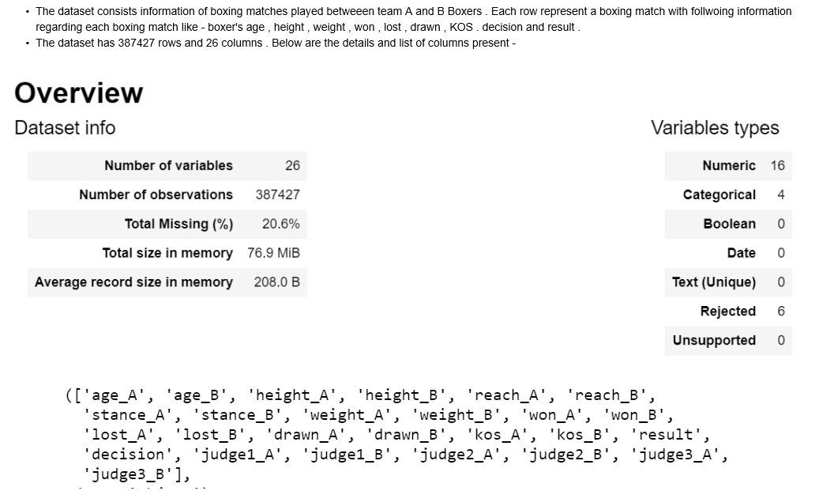
Boxing dataset information

Slide 3
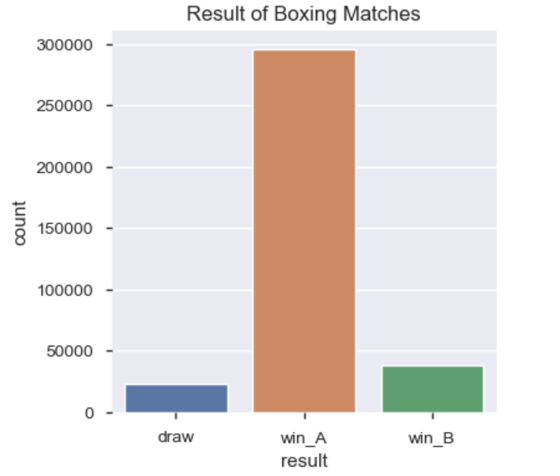
Of all the fights, who has won more fights (A or B) ?
A Boxers have won most fights

Slide 4
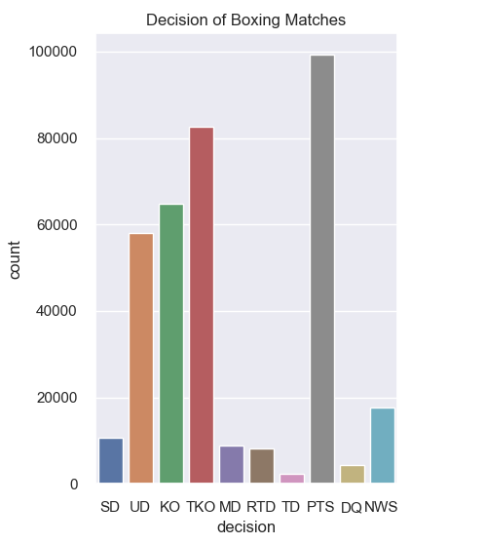
What is the reason of winning the fight ?
Most matches are won due to Knocked out (KO , TKO) , then comes PTS decision by points ..infact PTS is more likely decision

Slide 5
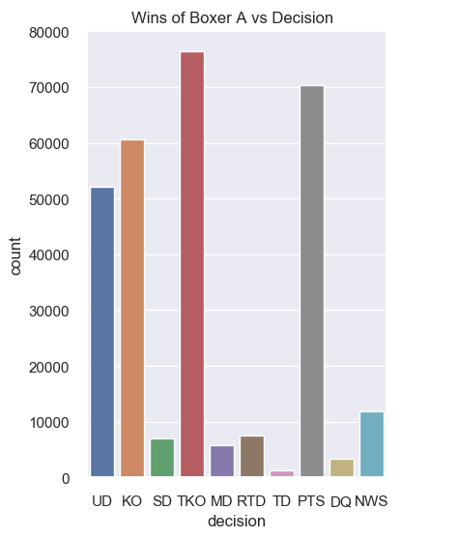
How is A Boxer's winning most of the fight ?
Boxer A won most of the matches through Knockout (KO, TKO) , point system is second most highest reason for A's win

Slide 6
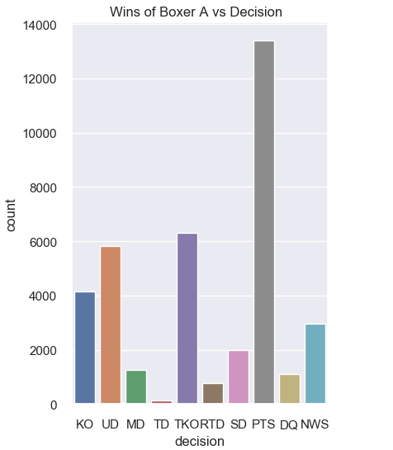
How is B Boxer's winning most of the fight ?
B Boxer's won most matches by PTS points decision, 2nd highest reason of win by Knockout (KO , TKO , UD) .. unanimous decision is also considerably high .
From the above 2 graph its clear that A is more probable to win matches than B , lets compare win A an win B vs Knockout decision
From the above 2 graph its clear that A is more probable to win matches than B , lets compare win A an win B vs Knockout decision

Slide 7
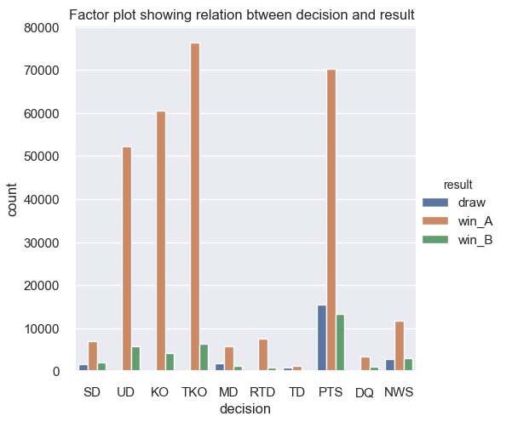
Off all the matches , what all decision lead to draw ..what is impact of NWS and SD ?
Matches which were drawn - decision was either SD split decision or MD mix decision or PTS by points , NWS .
That is most of the matches ended and played for all three rounds/bouts . and for most draw matches judges gave same score .
Most of matches won by Boxers A are KO or TKO that is they Knocked out the opponent and matches didnt ended till last .
matched won by TD techincal decision is very few which is expected .
result of winners declared NWS newspaper when the match ended without conclusion are good in numbers .
Most of the matches was decided by Knocked outs and then by points PTS .

Slide 8
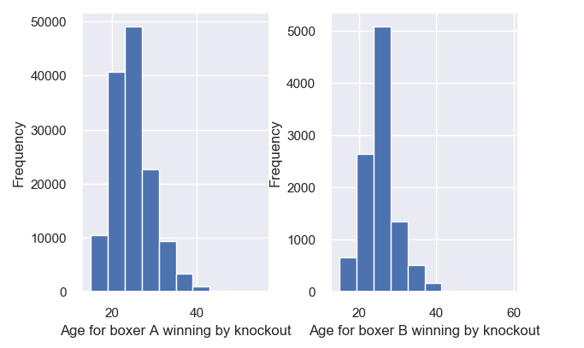
What is the most likely age of the fighters when they are knocking out the opponent?
we see age of both A and B boxer is 20-30 when he wins by knockout , so its 20-30 is most likely age for knockout opponent
after age of 40 boxer mostly dont win by knockout ..

Slide 9
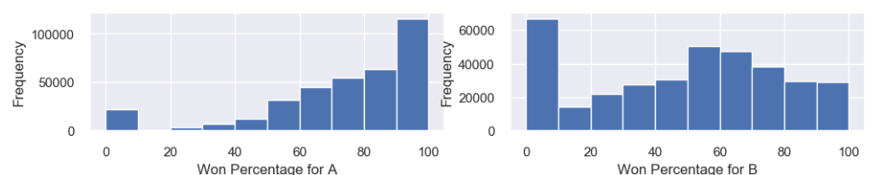
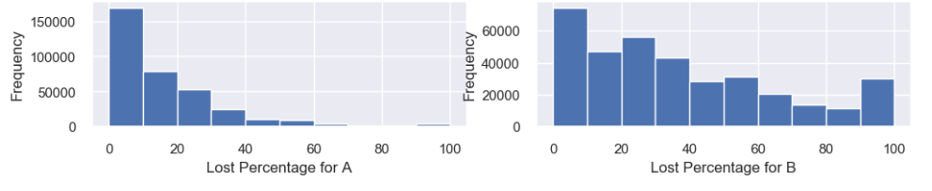
How was A boxer's and B boxer's past performance?
This shows that the performance of Boxer A is better than B , Most of boxer A won percentage lie between 80 to 100% . Very few boxer have won percentage less 40% Also almost 50% of boxer A have lost percentage with 10%
Boxer B has more won percentage in the range of 50%-70%.Huge chunk of B boxers has won percentage < 40%

Slide 10
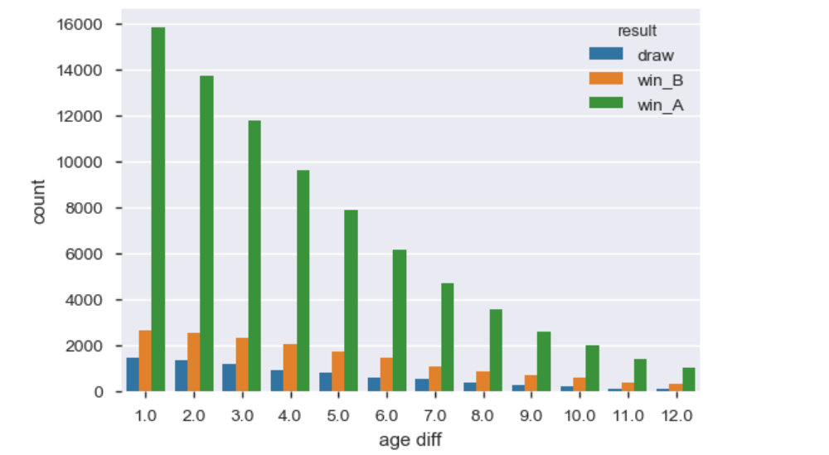
What is the impact of age diff b/w boxers
Looking at the graph we can say that as the age diff decrease chances of match being drawn increases or vice versa.
As the age diff increase - chances of team A winning decreases significantly
Boxer A wins over Boxer B irrespective of age .

Slide 11
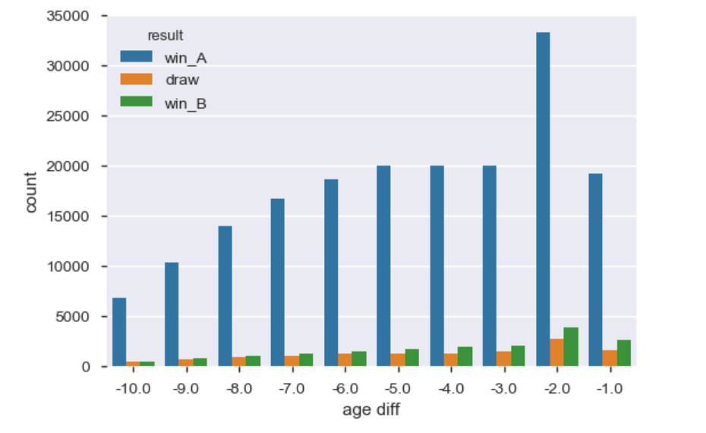
Continued – impact of age diff
Again we see, as the age difference decreases,the chances of draw siginificantly increases.
Here we are also see that as the age of Boxer B increases compared to Boxer A, the chance of Boxer B winning decreases significantly

Slide 12
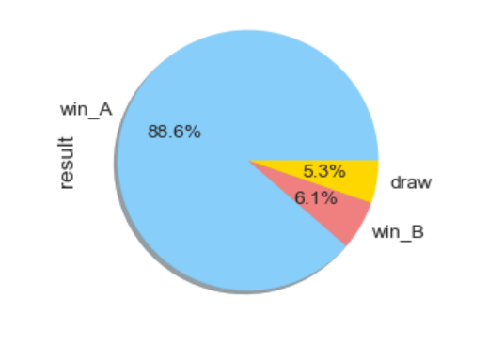
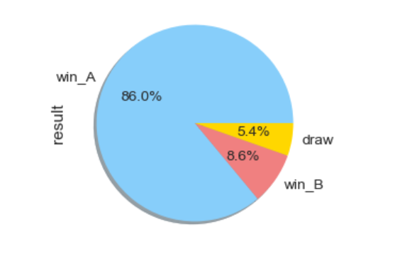
Are there boxers Playing there first match ?

Slide 13
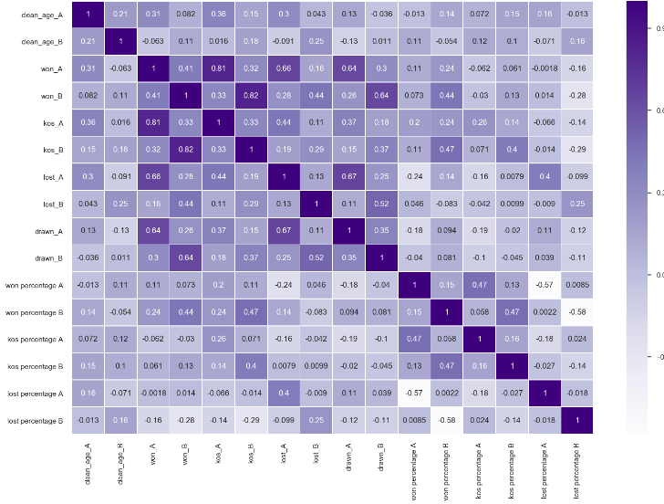
Heatmap – Correlation b/w columns
KOS and won are very tightly correlated
Won , Lost , Draw are tighly correlated as well

Slide 14
Conclusion
The boxing data helps us understand outcomes of matches
Total of __387427__ entries were present out of which around 75111 entries are of new Boxing fights where at least one of the Team is playing a new Player.
A Team is winning most of the fights
Boxers of A Team are more aggressive than B Team boxers. So they are winning most of the matches by knocking out the opponent.
A huge chunk of B Boxers has win percentage within 50-70%
A huge chunk of A Boxers has win percentage within 80-100% and lost percentage <10%
More new boxers are playing from B Team. New Boxers of B team are playing comparatively younger boxers of A Team. These new boxers are winning only 7% of the fights
Inexperienced Boxer of A Team are playing against older opponent. They are winning most of the fight (87%)
A Team is winning most of the matches when the decision is undecided or Newspaper Decision

